Slide 1
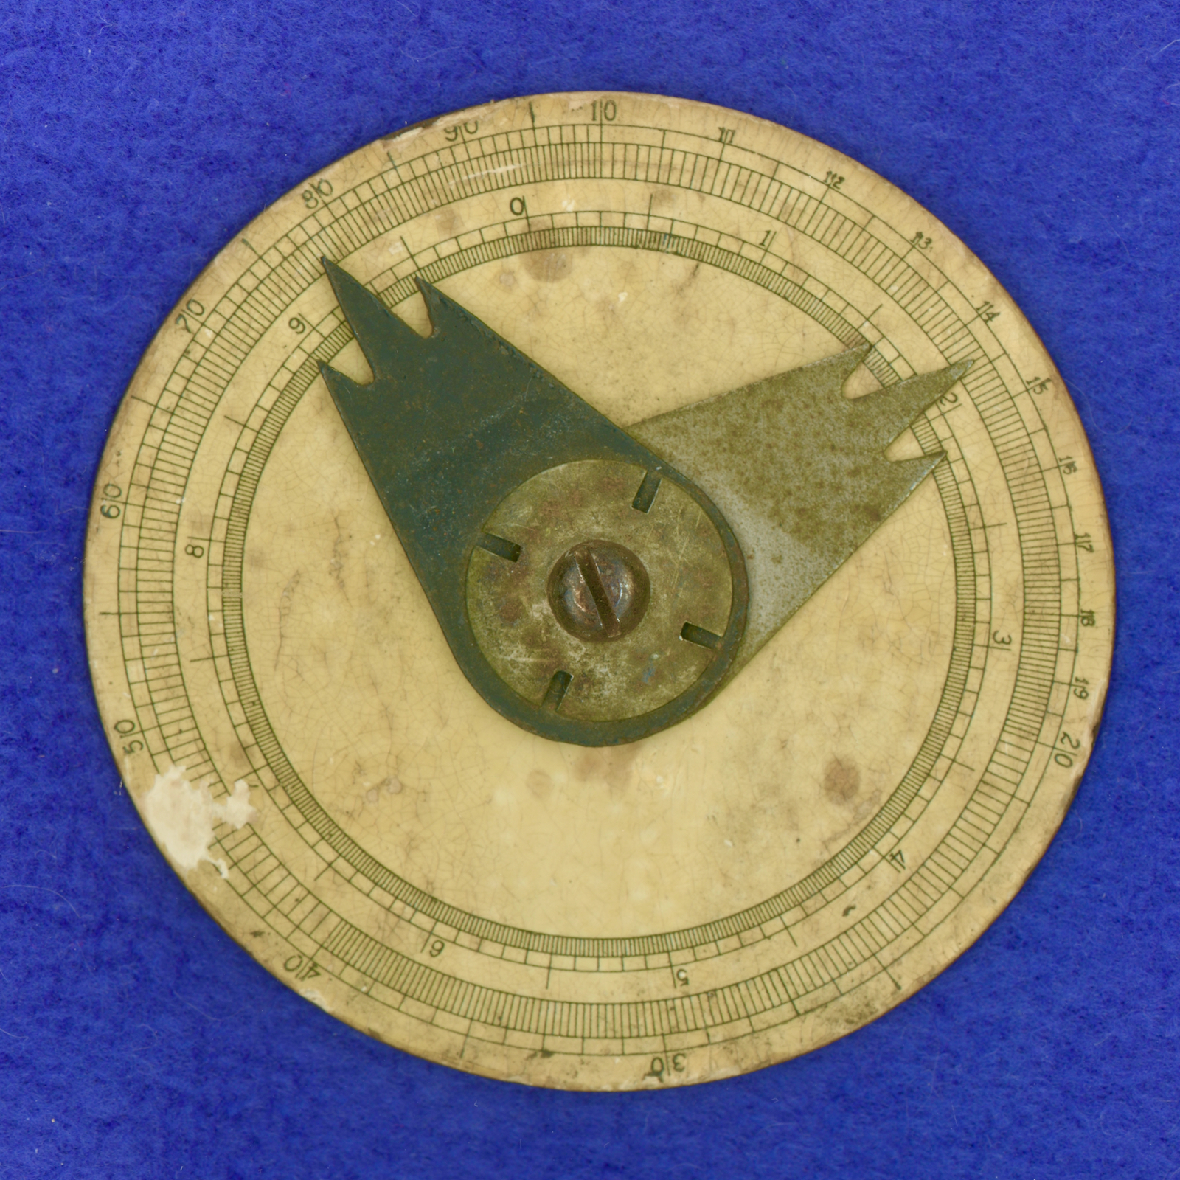
A Smoking Gun: The Gilson-Richardson Connection
John Runnels
Baton Rouge, Louisiana (USA)

Slide 2
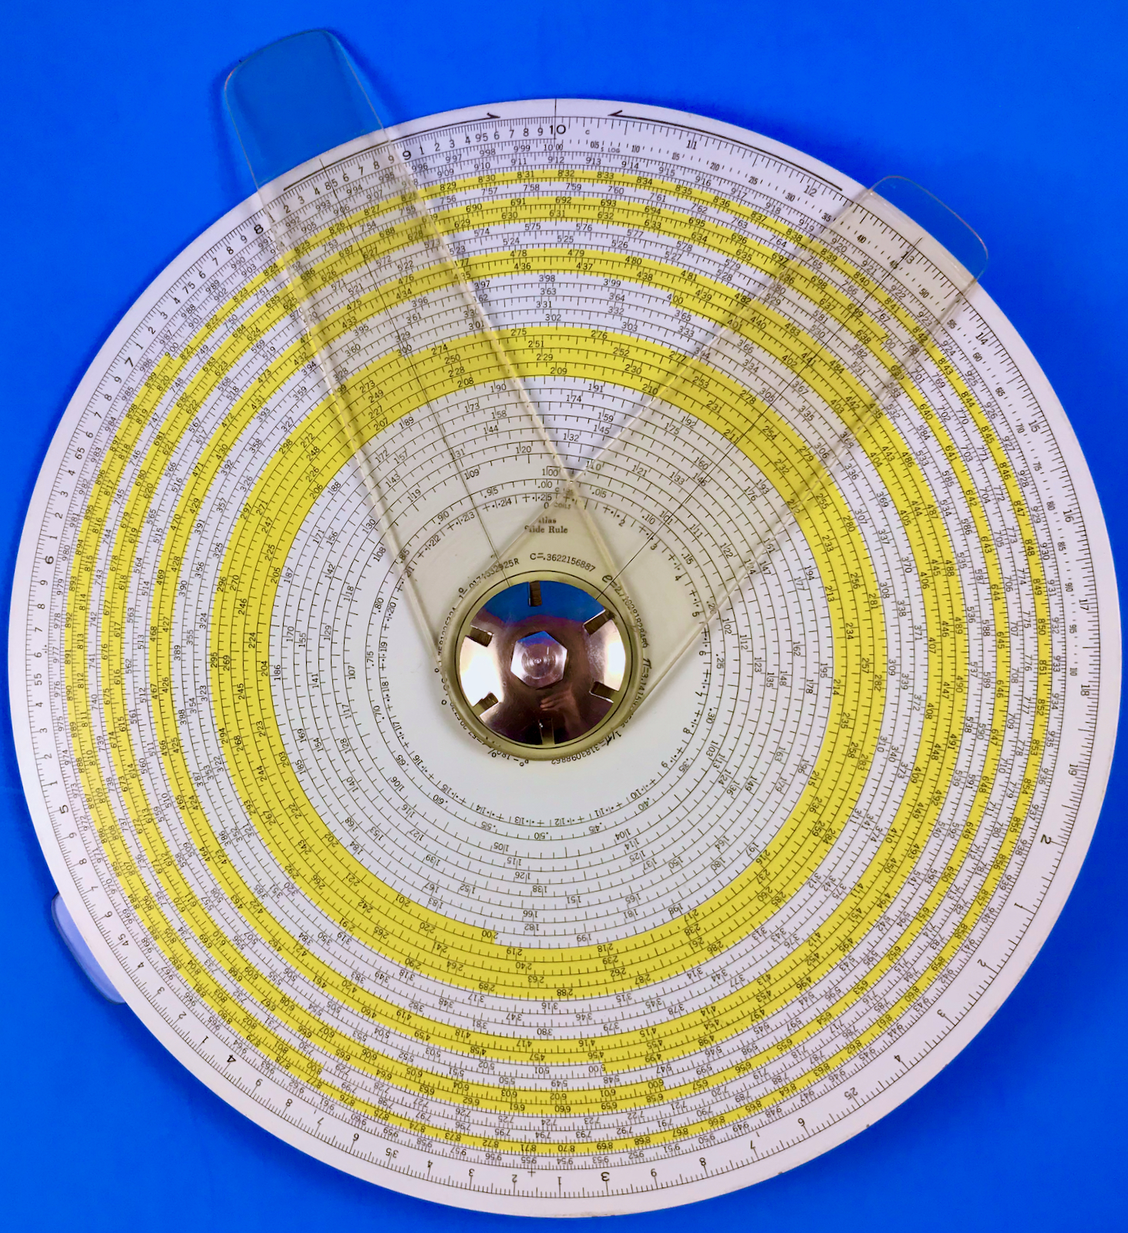
Gilson Atlas Type III Enamel Paint
on Aluminum, 1930s - 1960s

Slide 3
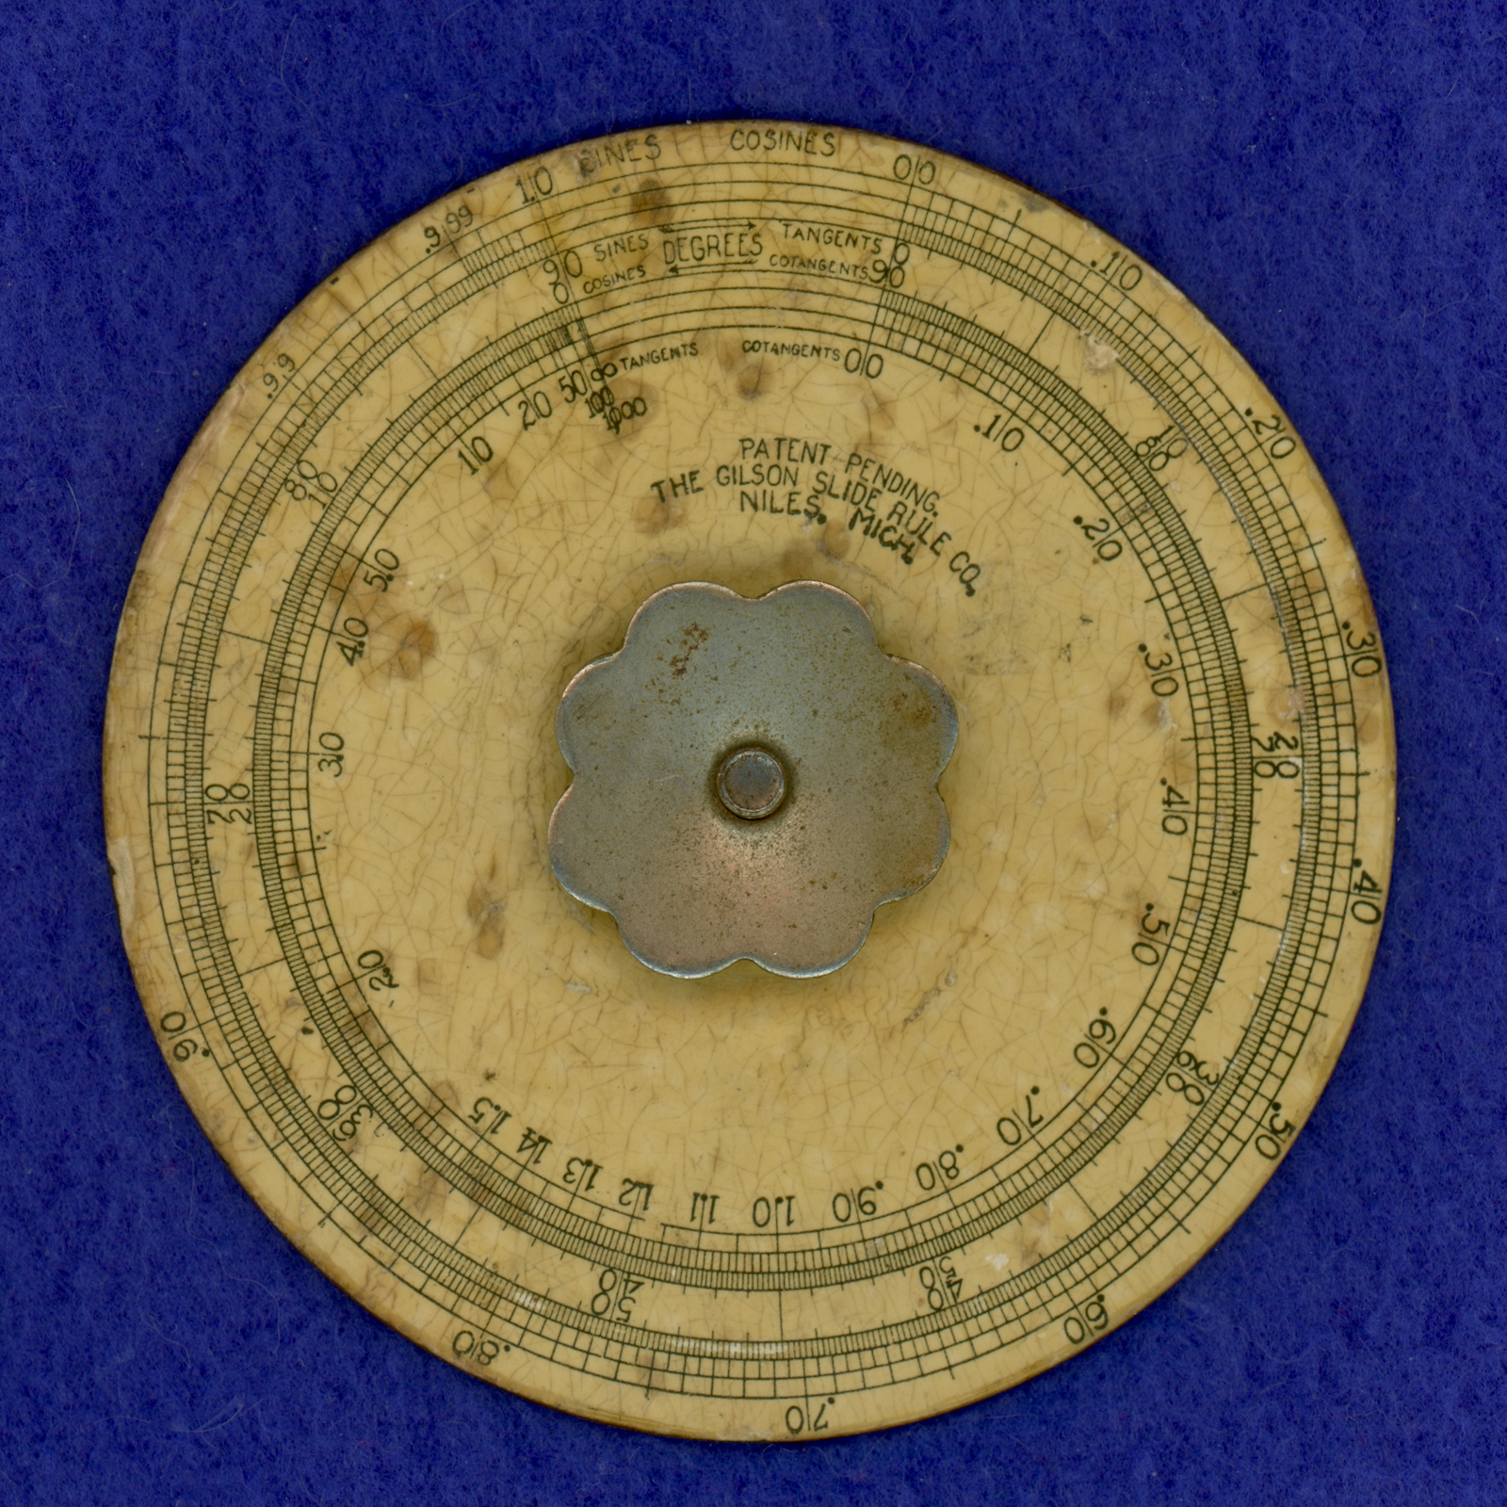
Gilson Midget Type I
Paper glued to Steel, ca. 1918

Slide 4
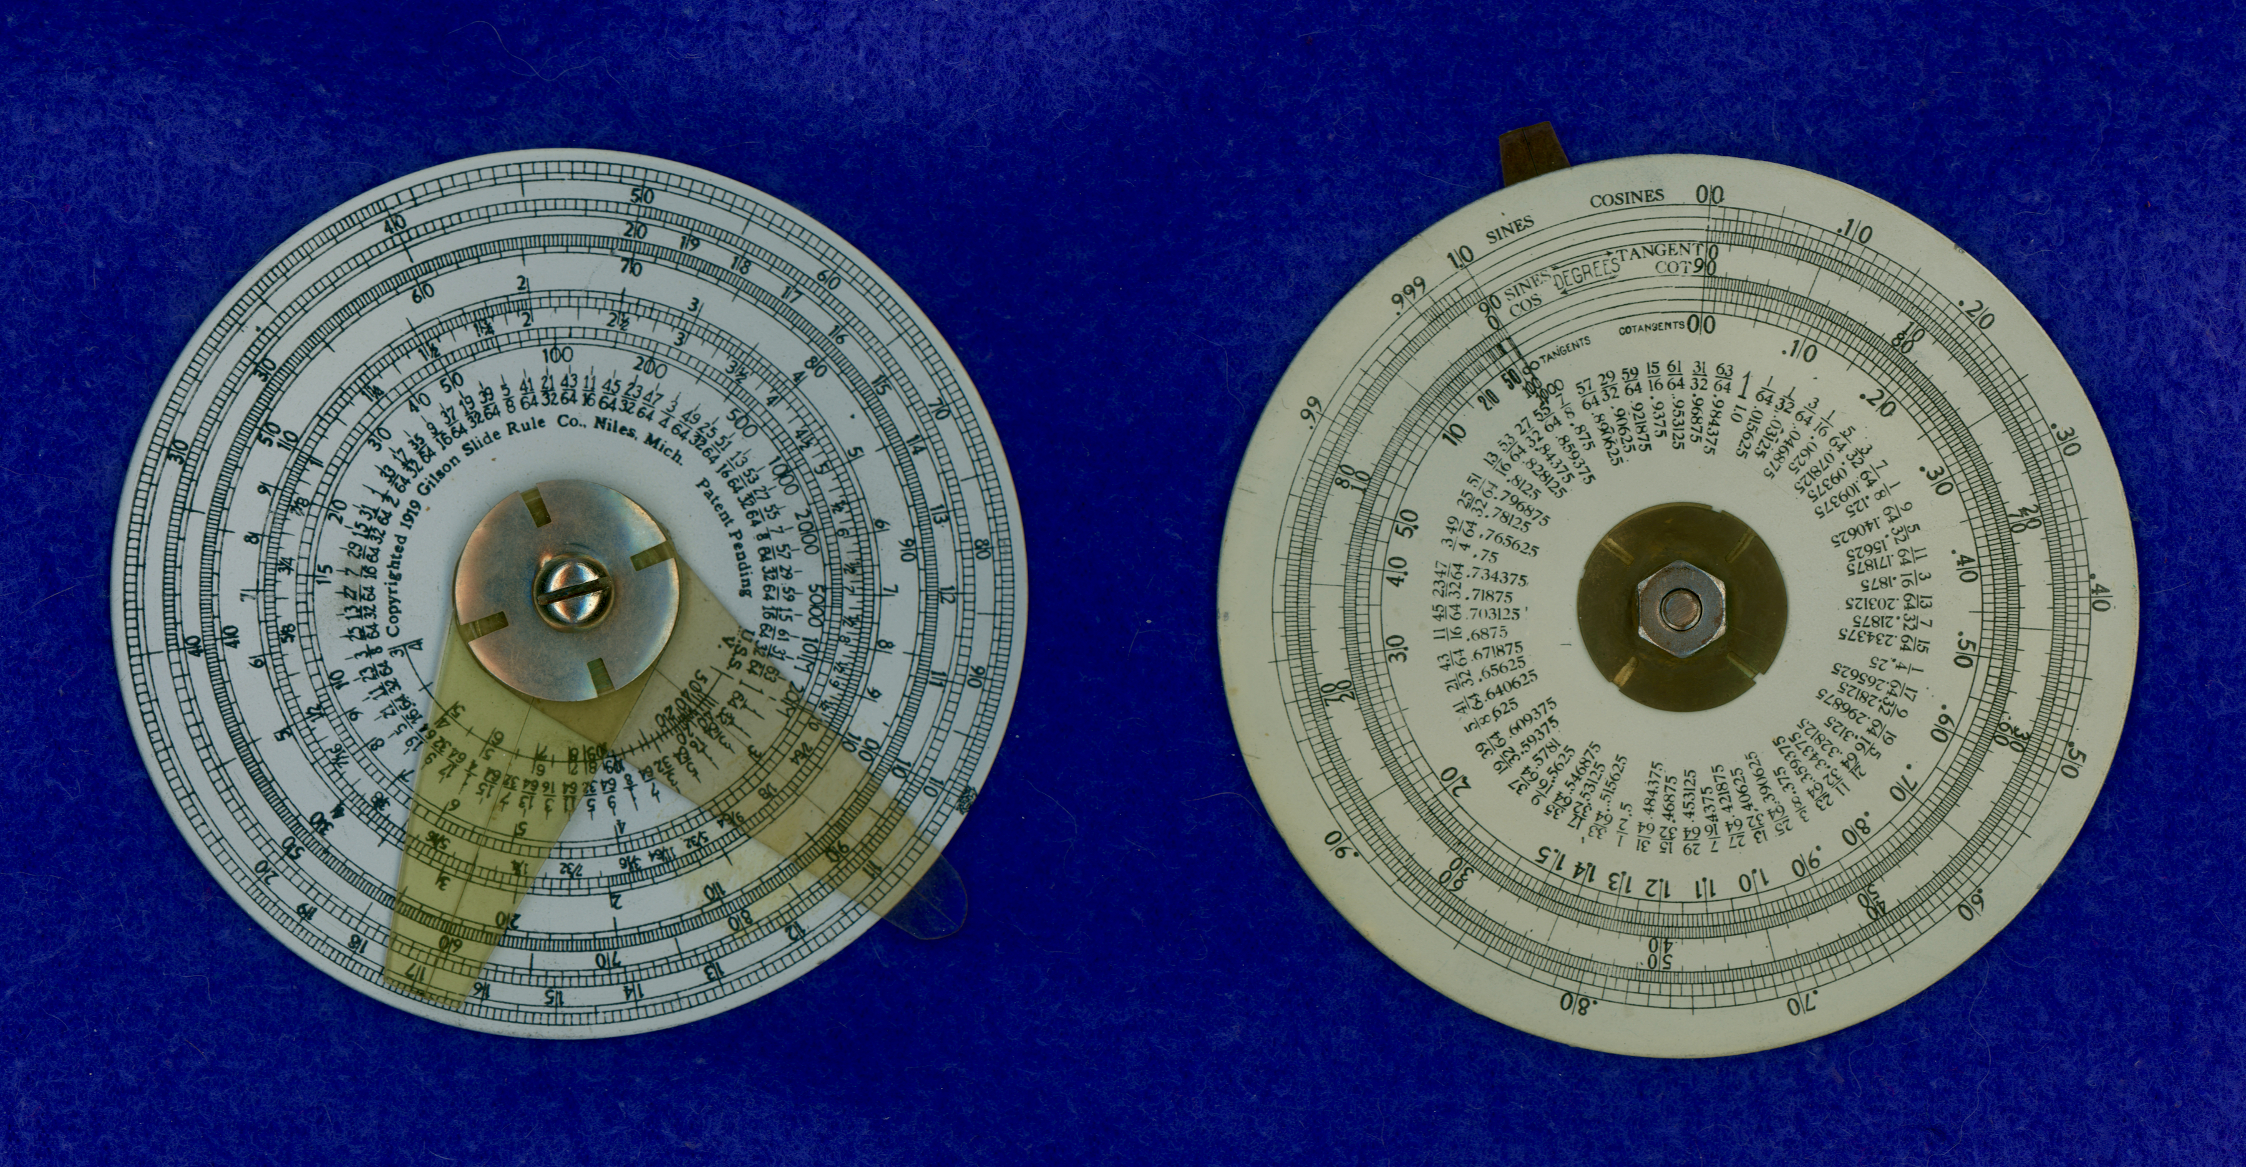
Gilson Midget Type II
Enamel Paint on Aluminum, ca. 1920

Slide 5
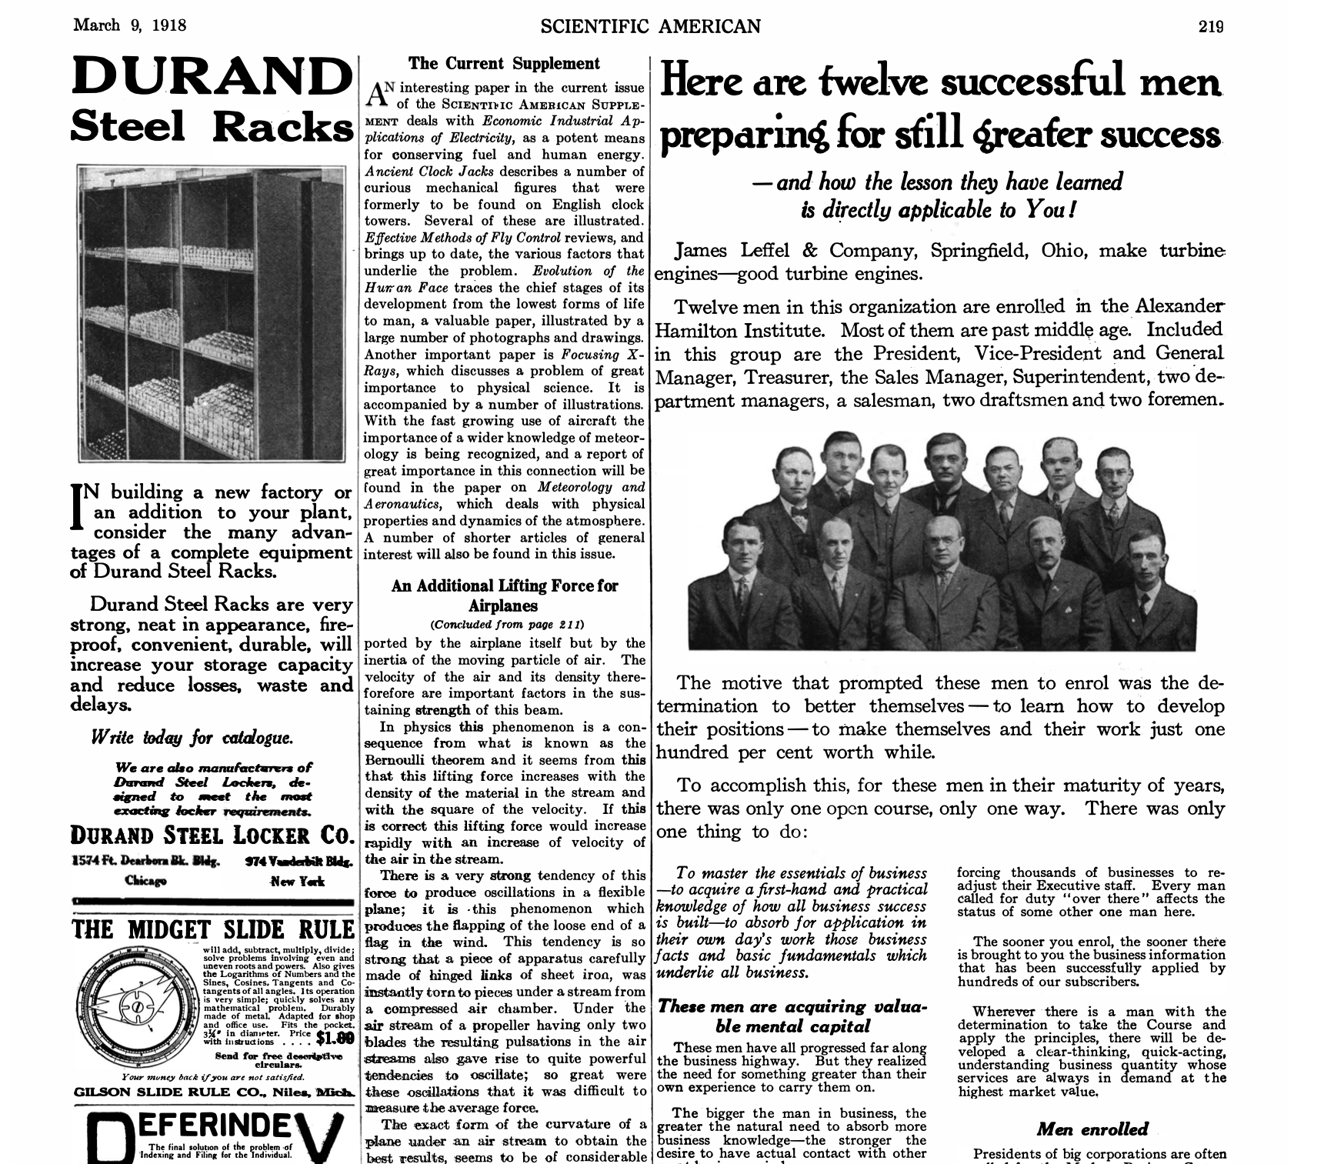
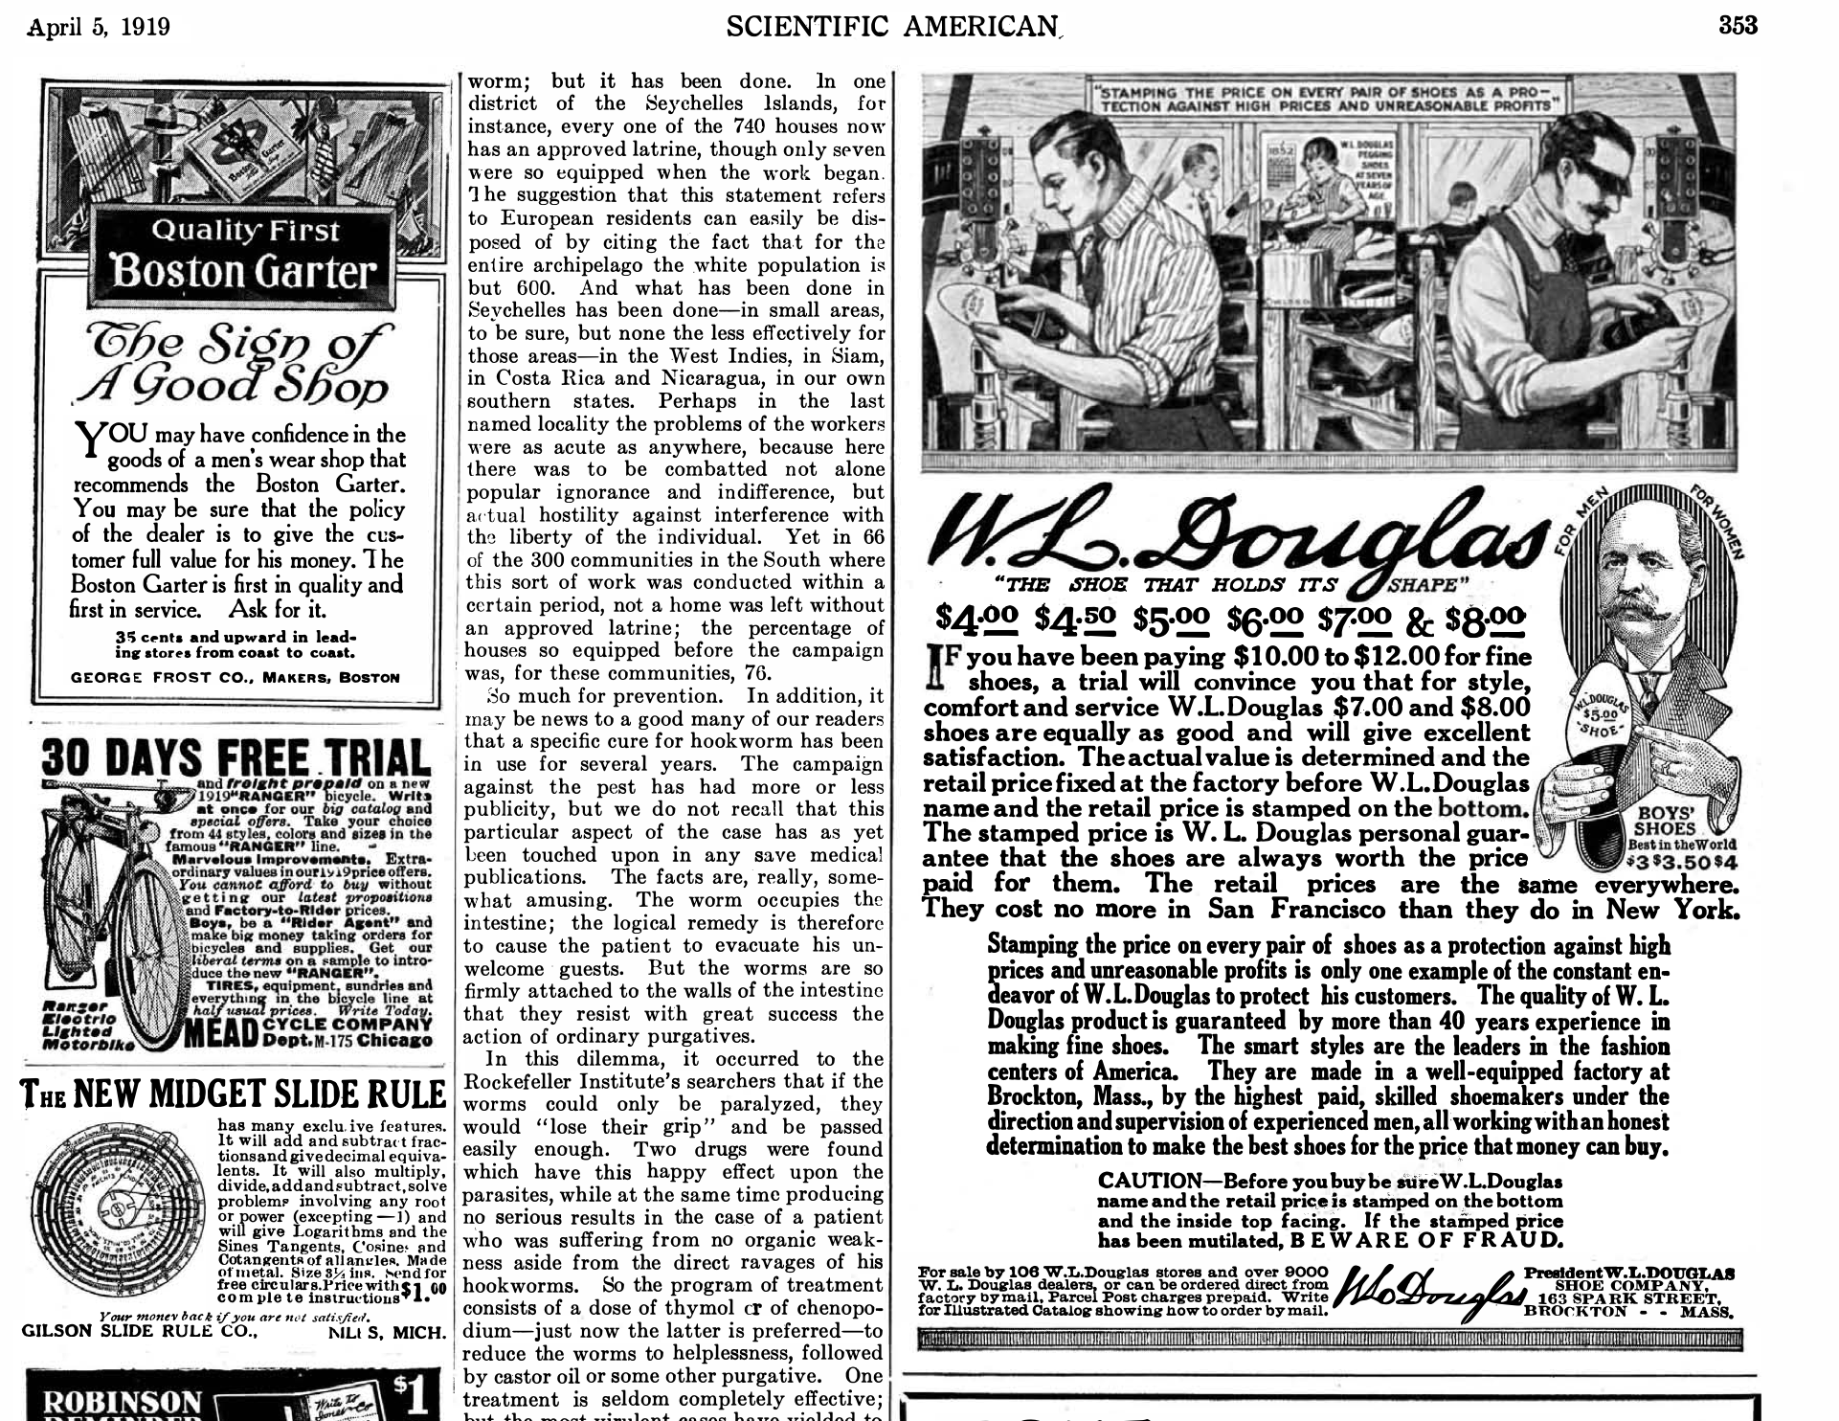
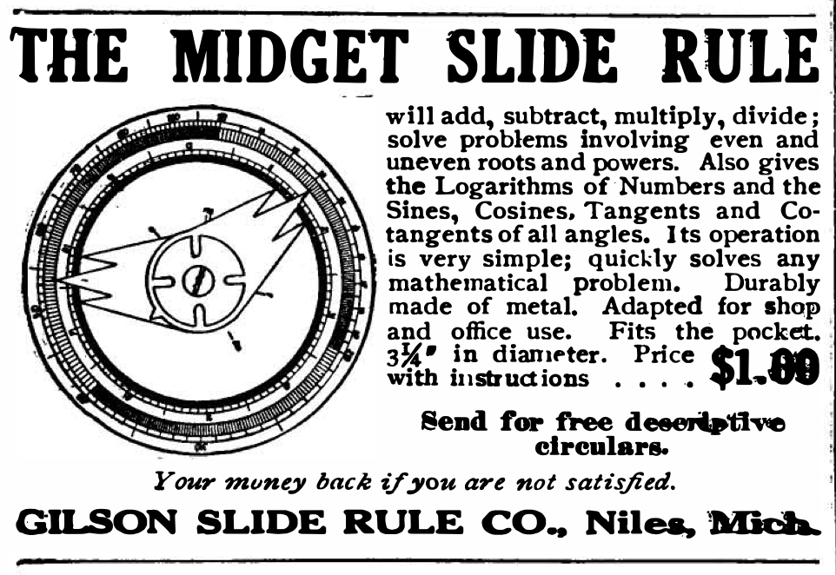
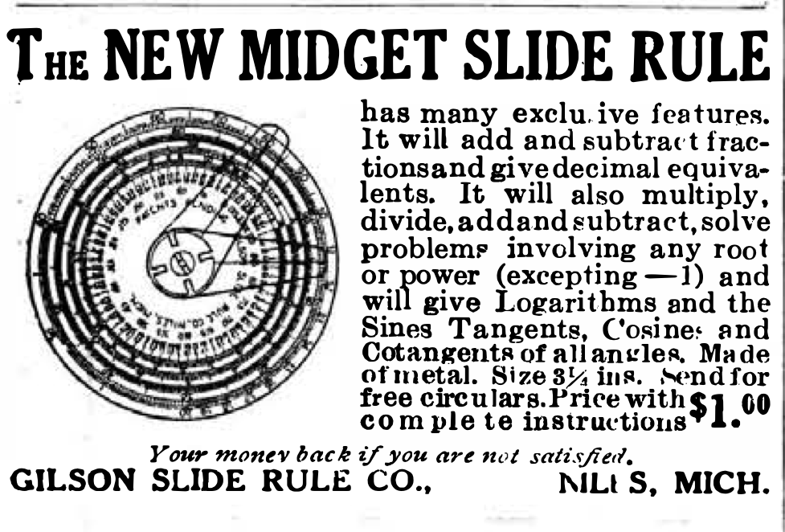

Slide 6
Richardson All-Metal Rule (enamel paint on steel)
Early 20th Century

Slide 7
A letter from Gilson’s son suggests Gilson made an 11-inch linear slide rule for Richardson. “This [letter] is the first concrete evidence of a relationship between the two companies other than the fact that both used the same owl as a logo, and that late Richardson catalogs carried the Gilson rules. It seems likely that Gilson bought out Richardson, but we probably will never have a definitive answer to the question.”
“If anyone has or knows of a combined Richardson and Gilson rule, please let us know, or, better yet, send in an article written on the subject.”
Journal of the Oughtred Society (1993) (comments perhaps by Robert Otnes or Rodger Shepherd?)

Slide 8
“[F]rom the available evidence . . . the Gilson Slide Rule Company purchased the Richardson Rule Works prior to 1920, most likely 1919. Gilson used Richardson’s printing technique to improve the resolution of his scales . . . . Both Richardson and Gilson were family-owned and family-run businesses, having created slide rules different from what was being produced at the time, but similar in their fabrication processes. Perhaps they liked to think they were like-minded and kindred spirits.”
Michael Konshak, Journal of the Oughtred Society, 2006

Slide 9
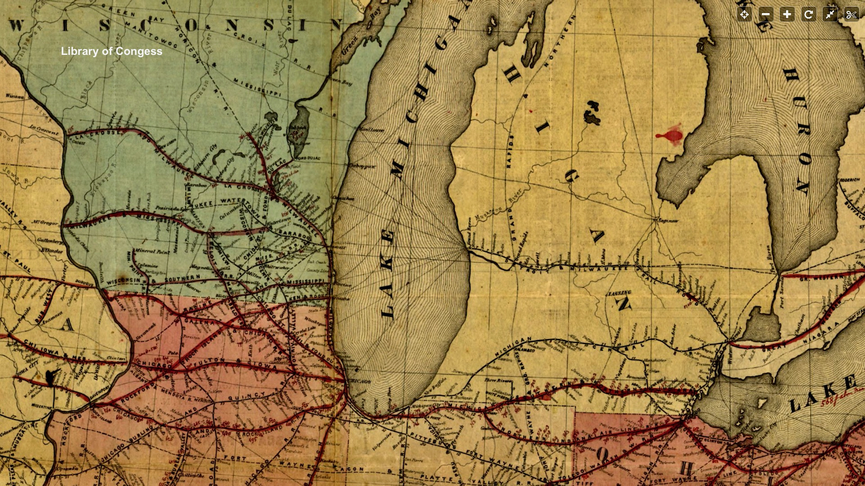
(1859)

Slide 10
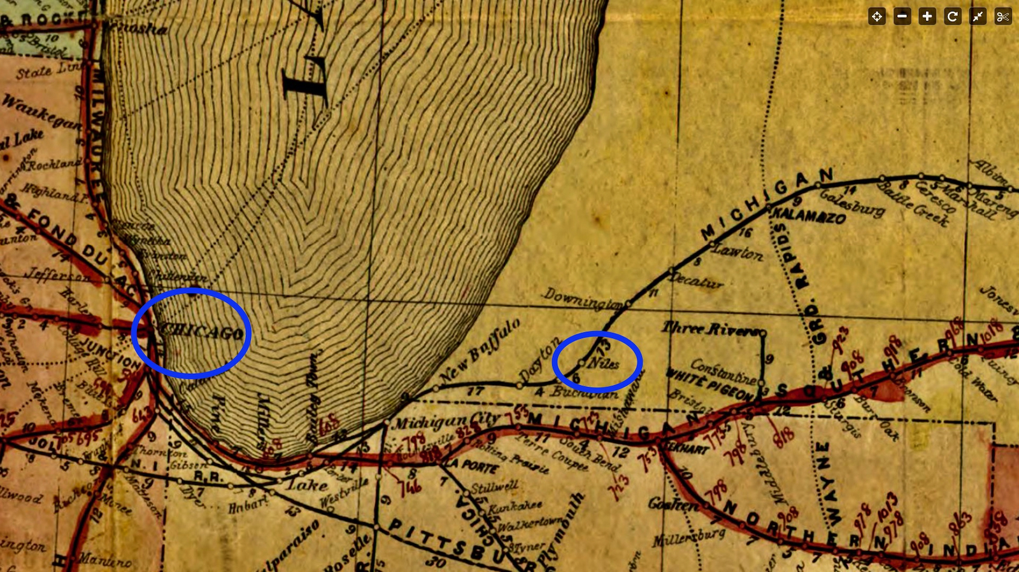
Chicago, Illinois Niles, Michigan Michigan Central Railroad

Slide 11
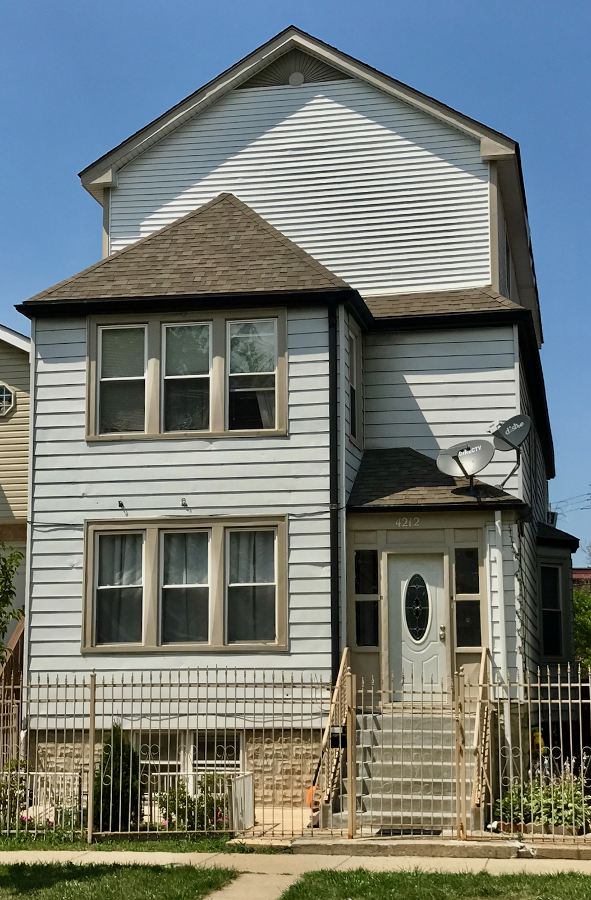
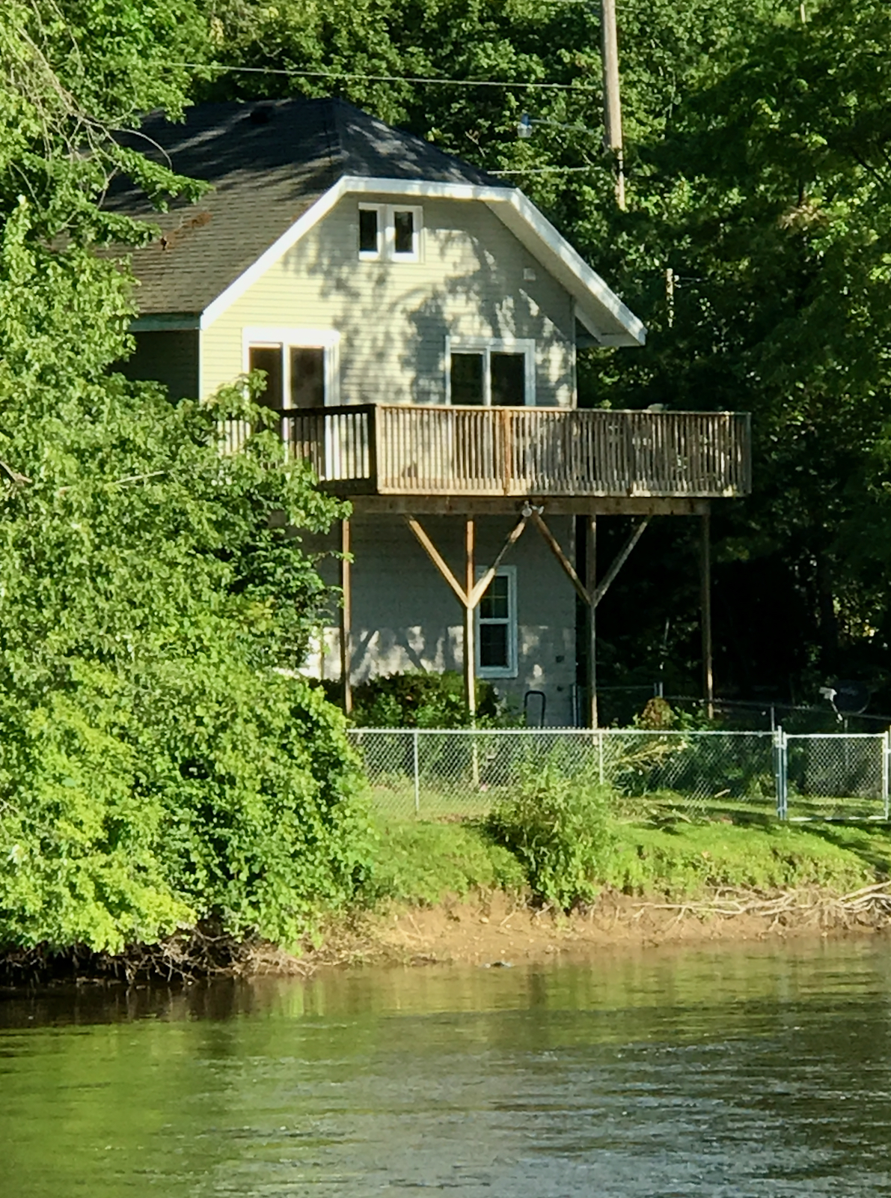
Richardson Home, Chicago, Illinois (2017) Gilson Home, Niles, Michigan (2017)

Slide 13
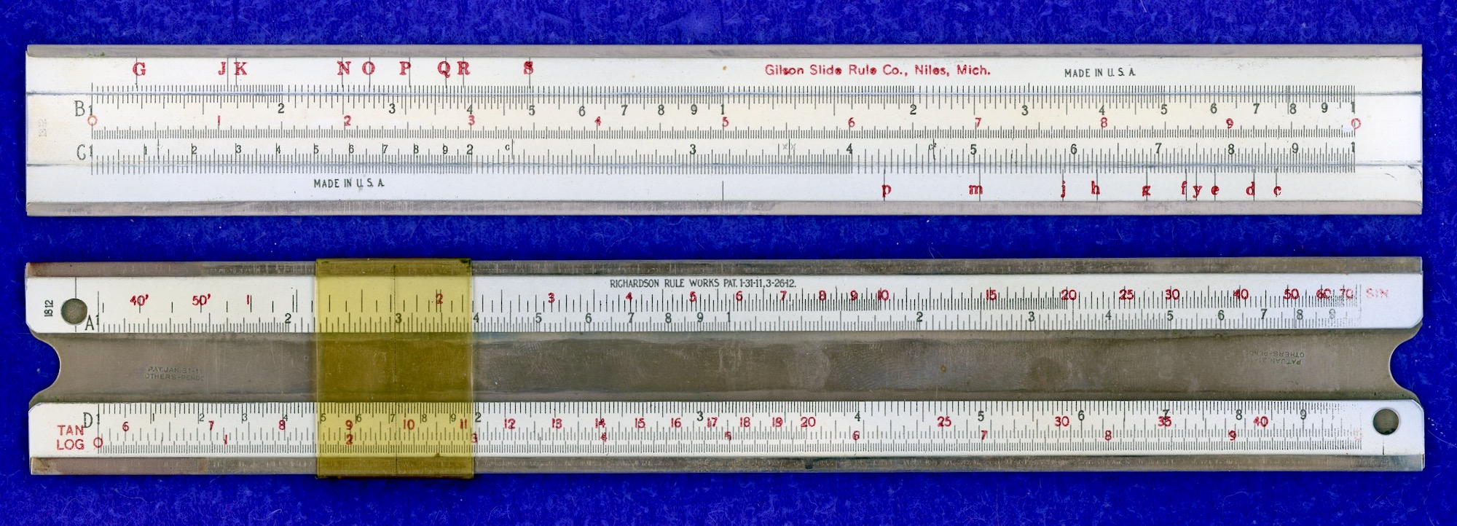

Slide 14
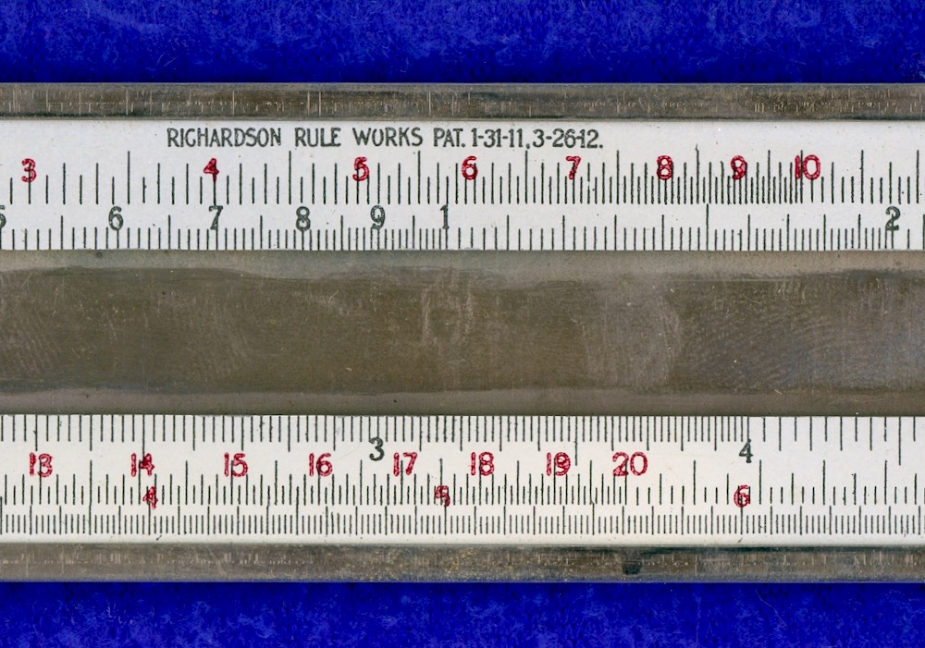

Slide 15
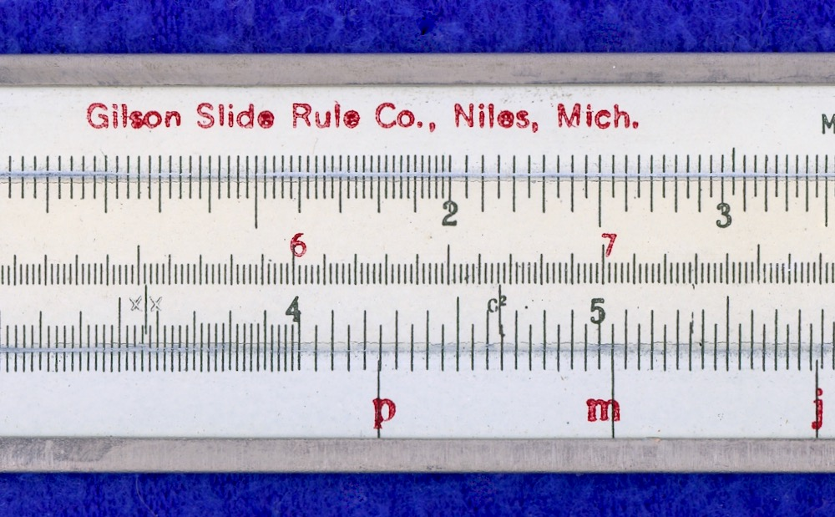

Slide 19
References
Aldinger, Henry, “The Gilson Slide Rule Company,” Journal of the Oughtred Society, 1:1, 1992
“Richard A. Gilson,” Journal of the Oughtred Society, 2:2, 1993
Shure, Conrad, “The Richardson-Gilson Connection,” Journal of the Oughtred Society, 6:2, 1997
Aldinger, Henry, “Comment on Richardson and Gilson Rules,” Journal of the Oughtred Society, 8:1, 1999
Konshak, Michael, “Richardson and Gilson,” Journal of the Oughtred Society, 15:1, 2006

